Slide 1

SRM Institute of Science and Technology, Ramapuram Campus DEPARTMENT OF COMPUTER SCIENCE AND ENGINEERING SATELLITE IMAGE CLASSIFICATION USING MACHINE LEARNING Batch NO : 14
Presented By:
RA1911003020030 – A AKHIL
RA1911003020032 – K VISHAL
RA1911003020036 – K SURESH
RA1911003020044 – B PRUDHVI

Slide 2
Introduction
Satellite imaging, or remote sensing, is the scanning of the earth by satellite or high-flying aircraft in order to obtain information about it . There are many different satellites scanning the earth, each with its own unique purpose.
Satellites use different kinds of sensors to collect electromagnetic radiation reflected from the earth.
Passive sensors collect radiation which the sun emits and the earth reflects, and don’t require energy.
Active sensors emit radiation themselves, and analyze it after it is reflected back from the earth. active sensors require a significant amount of energy to emit radiation, but they are useful because they can be used during any season and time of day (passive sensors cannot be used on a part of earth that is in shadow) and because they can emit types of radiation that the sun does not provide.
Image classification has been very essential in the application of remote sensing systems, thus the demand for research to find advanced algorithms and tools to solve problems experienced in classification, has shown a great increase over the years. it is very important to classify images correctly because often the information derived from the analysis is utilized for vital decision making.

Slide 3
Abstract
Image classification entails the important part of digital image and has been very essential in the application of remote sensing systems, thus the demand for research to find advanced algorithms and tools to solve problems experienced in classification has shown great increase in interest over the years. remote sensing has globally being applied with the use of current advanced satellite systems and sensors, but the need to provide analysis and decision making has been a challenge.
This project will focus on devising of the algorithms for classification based on machine learning techniques. Applying machine learning techniques for the purpose of classification will be of great importance. Along with this the implementation of the newly devised algorithm(s) on gpu platforms will help in faster processing.

Slide 4
Problem STATEMENT
Satellite image classification plays a major role in extract and interpretation of valuable information from massive satellite images. The applications based on the satellite data are of great importance to the society. Accordingly efficient results of these satellite based applications is also necessary. So, this project will help in efficient classification of the satellite based data through the help of machine learning. Hence the applications built on the satellite image classification techniques will also produce the efficient results. Along with the use of GPU’s these techniques will also produce faster results.

Slide 5
Objectives
The main objective of the project is to devise new algorithm(s) for the classification process by applying machine learning techniques. And also Study of machine learning algorithms/techniques. Classification rules will be extracted from the spatial data. then it will be applied to classify the satellite image and then the accuracy assessment of the whole process will be done to check, whether there is any change in the classification accuracy. We also aim for Boosting up the performance by devising the algorithms that run on GPU platforms

Slide 6
Literature Survey
S.NO | NAME OF THE PAPER | NAME OF THE AUTHOR | YEAR OF PUBLISHIG | TOPIC DISCUSSED | Merits | Demerits
1 | Classification of Satellite Images Based on Color Features Using Remote Sensing | 1.Assad H. Thary Al-Ghrairia 2.Zahraa H. Abedb 3.Fatimah H. Fadhilc 4.Faten K. Naser | 2018 | K-means clustering algorithm, Color Moments | Simple to implement, scales to large datasets & adapts to new examples easily | Lacks consistency, Failed to handle outliers and noisy data
2 | Optical Cloud Pixel Recovery via Machine Learning | 1.Parth Sarathi Roy 2.Prasad S. Thenkabail | 2017 | random forest | Pixel recovery at different climatic conditions | Limited training data & less accurate
3 | Satellite Images Classification in Rural Areas Based on Fractal Dimension | 1.Mohammed Sahib Mahdi 2. Aqeel Abboud Abdul Hassan | 2016 | quadtree, box counting, fractal dimension, supervised classification | High resolution in segmentation & classification | Small range with limited boundaries
4 | Machine learning in geosciences and remote sensing | 1.David J. Lary 2.Amir H. Alavi 3.Amir H.Gandomi 4.Annette L. Walker | 2016 | Regression, classification | Effective Classification of datasets | Low resolution & quality

Slide 7
S.NO | NAME OF THE PAPER | NAME OF THE AUTHOR | YEAR OF PUBLISHIG | TOPIC DISCUSSED | MERITS | DEMERITS
5 | Satellite Image Classification Using Moment and SVD Method | 1.Mohammed S. Mahdi Al-Taei 2. Assad H. Thary Al-Ghrairi | 2016 | block-based classification, pixel-based classification, SVD, Moment. | Data simplification, improve algorithm results | Complex method and applicable to small datasets
6 | Satellite Image Enhancement Using DWT – SVD and Segmentation Using MRR –MRF Model | S. Brindha | 2015 | Multi Region Resolution, Markov Random Field | Improves segmentation and noise free | Low frequency in pixel alignment
7 | Satellite Image Classification Based on Fuzzy with Cellular Automata | 1.Harikrishnan.R 2.S.Poongodi | 2015 | Cellular automata algorithm | Splitting and organizing patterns | it has low accuracy and quality

Slide 8
Existing Systems
The main limitation of random forest is that a large number of trees can make the algorithm too slow and ineffective for real-time predictions. in general, these algorithms are fast to train, but quite slow to create predictions once they are trained.
Decision tree is a supervised learning technique that can be used for both classification and regression problems, but mostly it is preferred for solving classification problems.
They are unstable, meaning that a small change in the data can lead to a large change in the structure of the optimal decision tree.
They are often relatively inaccurate.
The most important limitations of simple k-means are:
The user has to specify k (the number of clusters) in the beginning. k-means can only handle numerical data. k-means assumes that we deal with spherical clusters and that each cluster has roughly equal numbers of observations.

Slide 9
Proposed system
In this system it creates a smaller dataset from multiple bands, while retaining as much original spectral information as possible. the result is a set of uncorrelated image bands, called pc bands. Reveal complex relationships among spectral features.
It reduces the number of variables of a data set naturally comes at the expense of accuracy, but the trick in dimensionality reduction is to trade a little accuracy for simplicity. Because smaller data sets are easier to explore and visualize and make analyzing data much easier and faster for machine learning algorithms without extraneous variables to process.

Slide 10
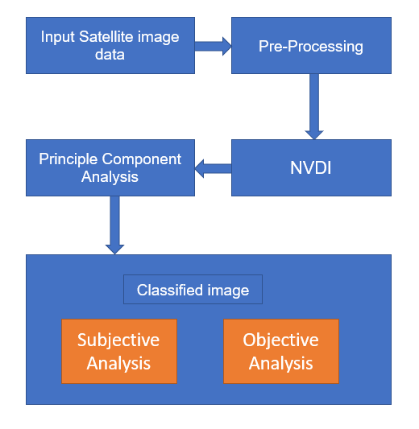
System Architecture

Slide 11
Algorithms used:
Principal Component Analysis:
Principal component analysis (PCA) is an unsupervised, non-parametric statistical technique primarily used for exploratory data analysis, dimensionality reduction, information compression, data de-noising, dimensionality reduction in machine learning.
Normalized Difference Vegetation Index:
The normalized difference vegetation index (NDVI) is a simple graphical indicator that can be used to analyze remote sensing measurements, often from a space platform, assessing whether or not the target being observed contains live green vegetation.
It detects and quantifies the presence of live green vegetation using this reflected light in the visible and near-infrared bands.

Slide 12
Modules
Data Products
Data Preprocessing
Spectral Profiles
Image Classification
There are 4 modules in this project. Each of the four modules has its own significant role in accomplishing the necessary task. These modules together completes the design of the system architecture for implementing the principal component analysis along with NDVI to do the image classification and producing the effective analysis.

Slide 13
Data products
Most remote sensing products consist of observations of reflectance data. That is, they are measures of the intensity of the sun’s radiation that is reflected by the earth. Reflectance is normally measured for different wavelengths of the electromagnetic spectrum. for example, it can be measured in the red, green, and blue wavelengths. If that is the case, satellite data can be referred to as “multi-spectral” (or hyper-spectral if there are many separate wavelengths).
The data are normally stored as raster data (referred to as “images”). Each separate image (for a place and time) is referred to as a s “scene”. As there are measurements in multiple wavelengths, a single “satellite image” has multiple observations for each pixel, that are stored in separate raster layers. in remote sensing, these layers (variables) are referred to as “bands” (shorthand for “bandwidth”), and grid cells are referred to as “pixel”.

Slide 14
Data Pre-processing
Satellite observations from one time period need to be aligned so that they can be compared and used to identify areas and changes. The steps required to do this are called pre-processing.
Pre-processing involves geometric and radiometric calibration, and in the case of SAR data, speckle filtering. geometric calibration, also called orthorectification, corrects for the angle of view of the satellite sensor, the relief of the terrain and lens distortions so that images from different sensors at different times can be compared in the same way as maps made using the same projection and scale can be compared. radiometric calibration is needed because the appearance of the same image varies with angle of view and illumination conditions.

Slide 15
Spectral Profiles
A plot of the spectrum (all bands) for pixels representing a certain earth surface features (e.g. water) is known as a spectral profile. Such profiles demonstrate the differences in spectral properties of various earth surface features and constitute the basis for image analysis. Spectral values can be extracted from any multispectral data set using extract function.
Spectral profile charts allow you to select areas of interest or ground features on the image and review the spectral information of all bands in a chart format. A spectral profile consists of geometry to define the pixel selection and an image with key metadata from which to sample.

Slide 16
Image Classification
Unsupervised Classification
Unsupervised classification is a process of clustering satellite image pixels into unlabeled classes/clusters. The image classification concepts aids in unsupervised classification to provide an access into image features for clustering, which can be analyzed in term of classification quality. The result of an unsupervised classification is an image of statistical features clusters.
Supervised Classification
Supervised classification is a process of sorting pixels into a number of individual classes based on the comparison with training sets. such methods require training set to be implemented, the data set predefined region of image belong to different classes in the image. The enrollment of the data set is an important primary stage in the supervised satellite image classification methods. the quality of a supervised classification depends on the quality of the training set. The supervised classification usually has the following sequence of operations: defining of the training sites, dataset (or, signatures) extraction, and image classification.

Slide 17
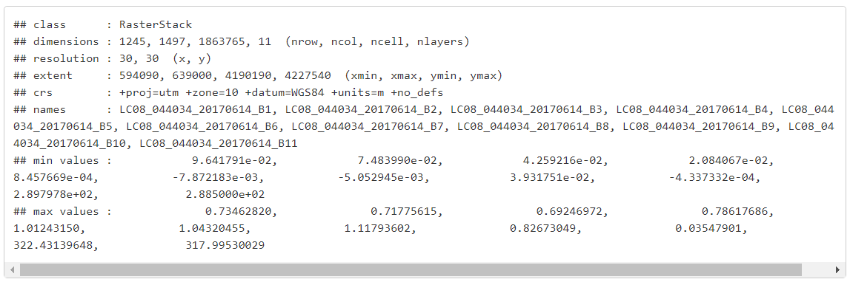
Image information and statistics
Above we created a rasterstack with 11 layers. the layers represent reflection intensity in the following wavelengths: ultra blue, blue, green, red, Near infrared (NIR), Shortwave infrared (SWIR) 1, Shortwave infrared (SWIR) 2, Panchromatic, cirrus, Thermal infrared (TIRS) 1, Thermal infrared (TIRS)

Slide 18
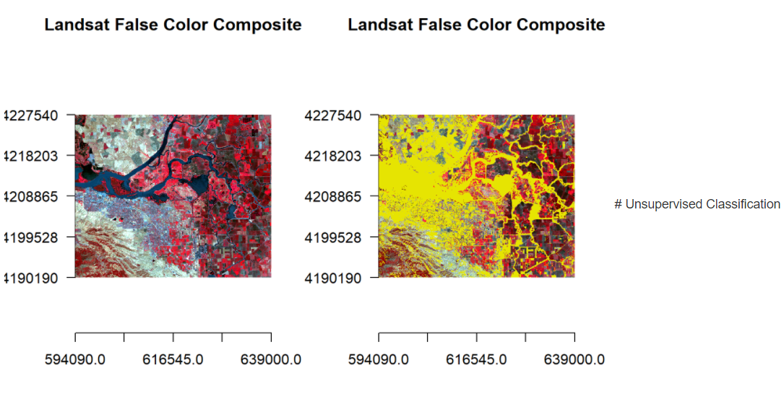
Classification of False Color Composite

Slide 19
Conclusion
Satellite image classification plays an important role in providing the geographical information. It provides the quantitative and qualitative information that reduces field work and study complexity. The purpose of using PCA is to reduce the dimensionality of the data in order to maximize the amount of information from the original bands into the smallest number of pcs. In this work NDVI is combined with the PCA and the results are compared with the PCA. the experimental results are better for proposed method than existing method.

Slide 20
References
[1] DAVID J. LARY, AMIR H. ALAVI, AMIR H. GANDOMI, ANNETTE l. walker, “machine learning in geosciences and remote sensing”, geoscience frontiers, volume 7, issue 1, 2016, pages 3-10, ISSN 1674-9871.
[2] G. CHENG, J. HAN AND X. LU, "remote sensing image scene classification: benchmark and state of the art," in proceedings of the IEEE, vol. 105, no. 10, pp. 1865-1883, oct. 2017. DOI: 10.1109/jproc.2017.2675998.
[3] JUN CHEN, IAN DOWMAN, SONGNIAN LI, ZHILIN LI, MARGUERITE MADDEN, JON MILLS, NICOLAS PAPARODITIS, FRANZ ROTTENSTEINER, MONIKA SESTER, CHARLES TOTH, JOHN TRINDER, CHRISTIAN HEIPKE, “information from imagery: ISPRS scientific vision and research agenda”, ISPRS journal of photogrammetry and remote sensing, volume 115, 2016, pages 3-21, ISSN 0924- 2716.

